Slide 1
Weed Science Extension
Sarah Lancaster

Slide 2
Background

Slide 3
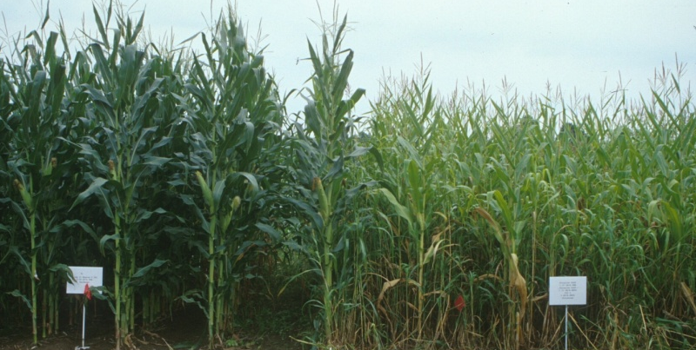
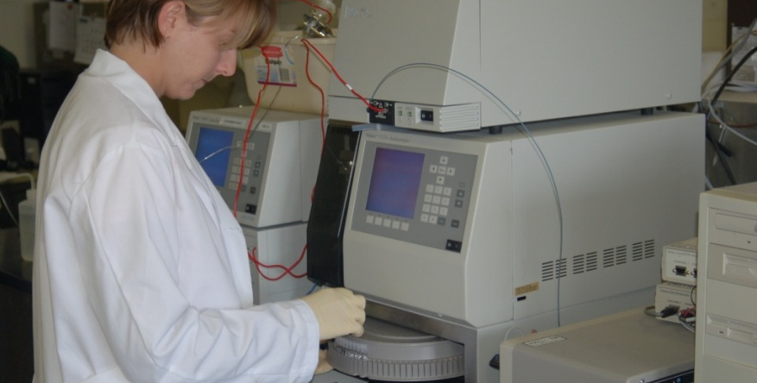
Education
B.S., Plant Science
University of Missouri
M.S., Crop Science
North Carolina State University
Ph.D., Agronomy
Texas A&M University

Slide 4
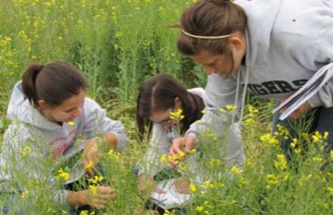
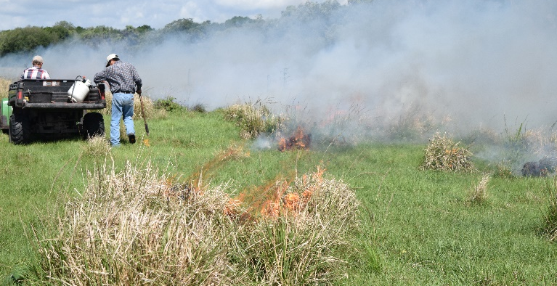
Professional Experience
Oklahoma State University
Plant and Soil Science
University of Florida
Range Management
Missouri State University
Environmental Plant Science & Natural Resources

