Slide 1
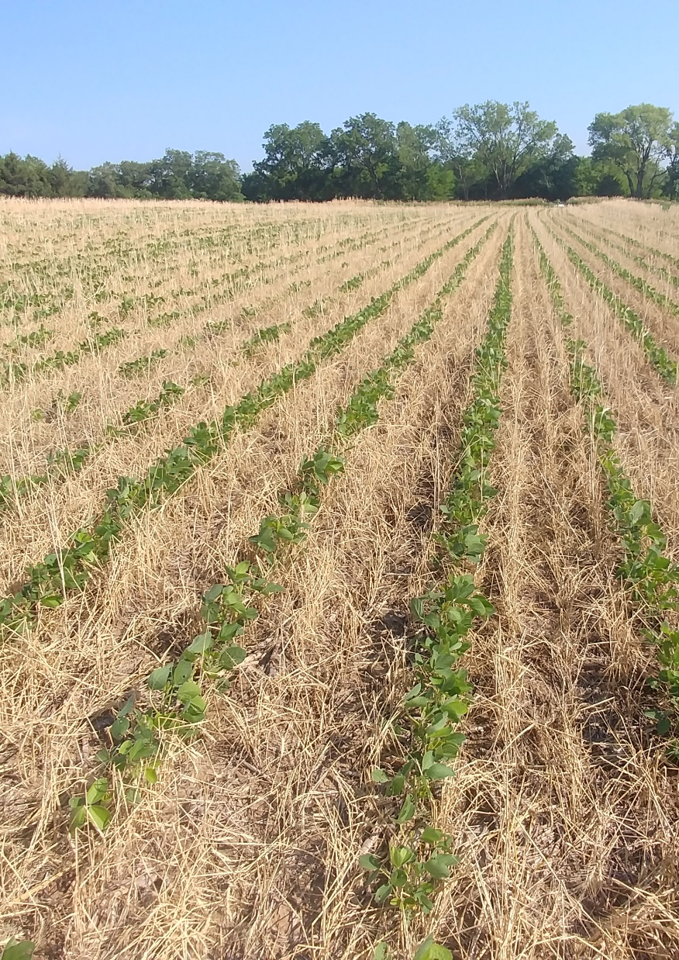

2019 NE Area Extension Update:
Connecting Environmental Aspects of Nutrient Management and Conservation Planning
Peter Tomlinson
Department of Agronomy
Notes:
Successful and comprehensive conservation planning necessitates a holistic approach. Planning must consider all of the conservation and production goals such as yield, soil health, soil conservation, nutrient management, water quality, sustainability, and climate resilience.

Slide 2
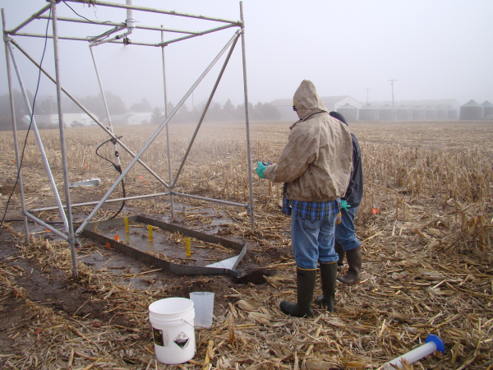
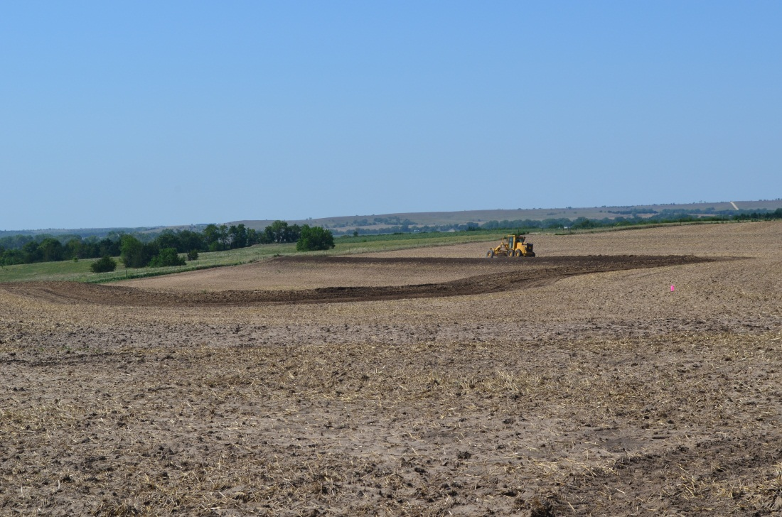
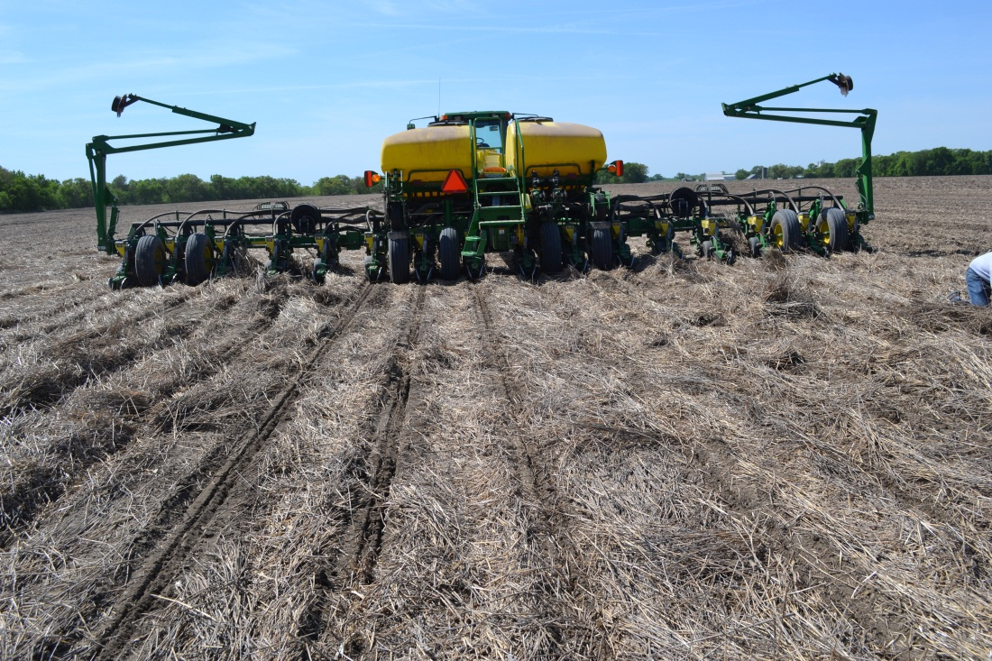
Structural Conservation Practice
Terraces and Terrace Maintenance
Waterways
Sediment basins for tile outlet terraces
Design Standards
  Rainfall amount
  Duration
  Intensity of events

Slide 3
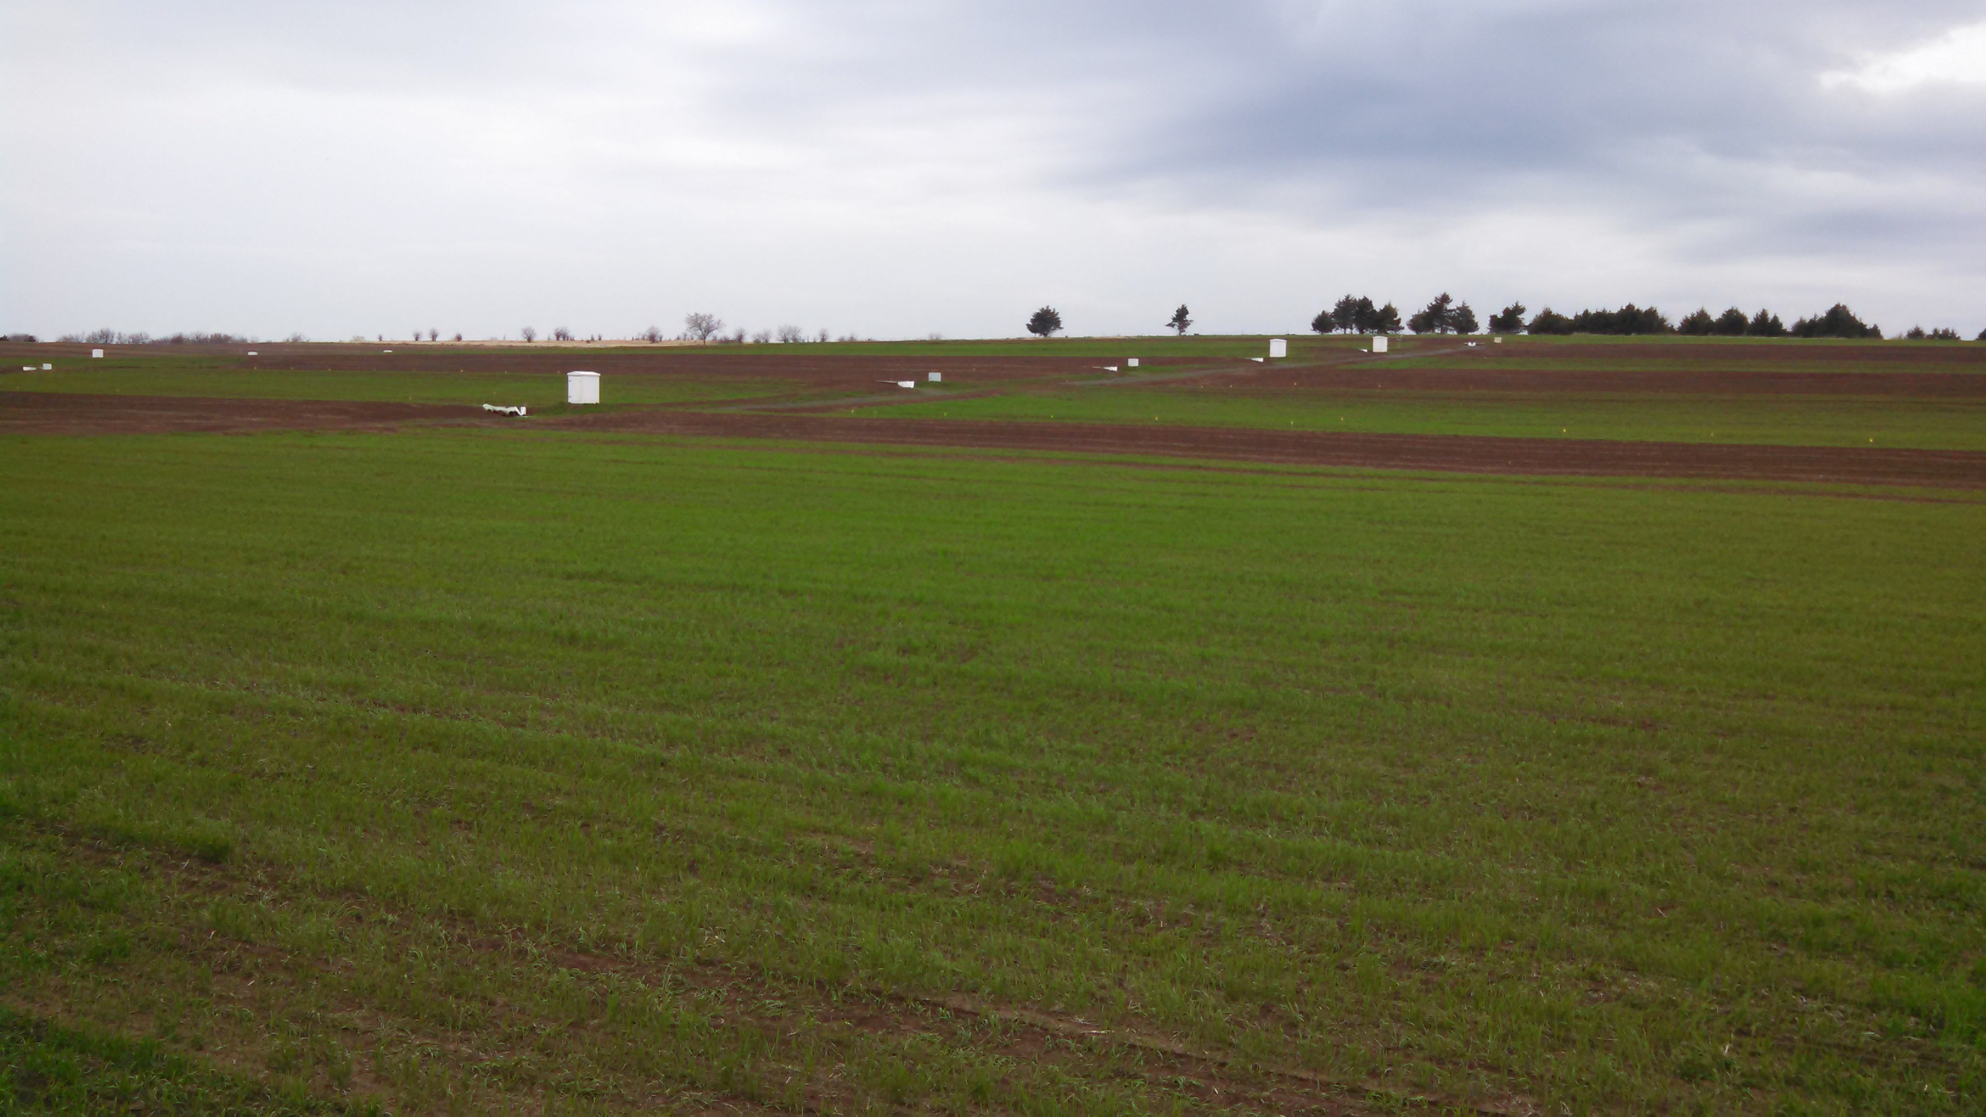
Managing for Soil Health
Minimize disturbance
  Reduce loss of aggregates
  Reduce loss of Organic Matter
Time activities
  Traffic when soil is dry
  Restrict tillage to optimum soil moisture
Protect the soil surface
  Crop residues/Cover crops
  Encourages soil biology
Add organic material
  Crop residue, compost, manure
  Stimulate microbial activity/stabilize aggregates
Incorporate cover crops where practical
  Root activity
  Organic matter
  Soil stabilization
Adapted from Brady and Weil, 14th edition 2007

Slide 4
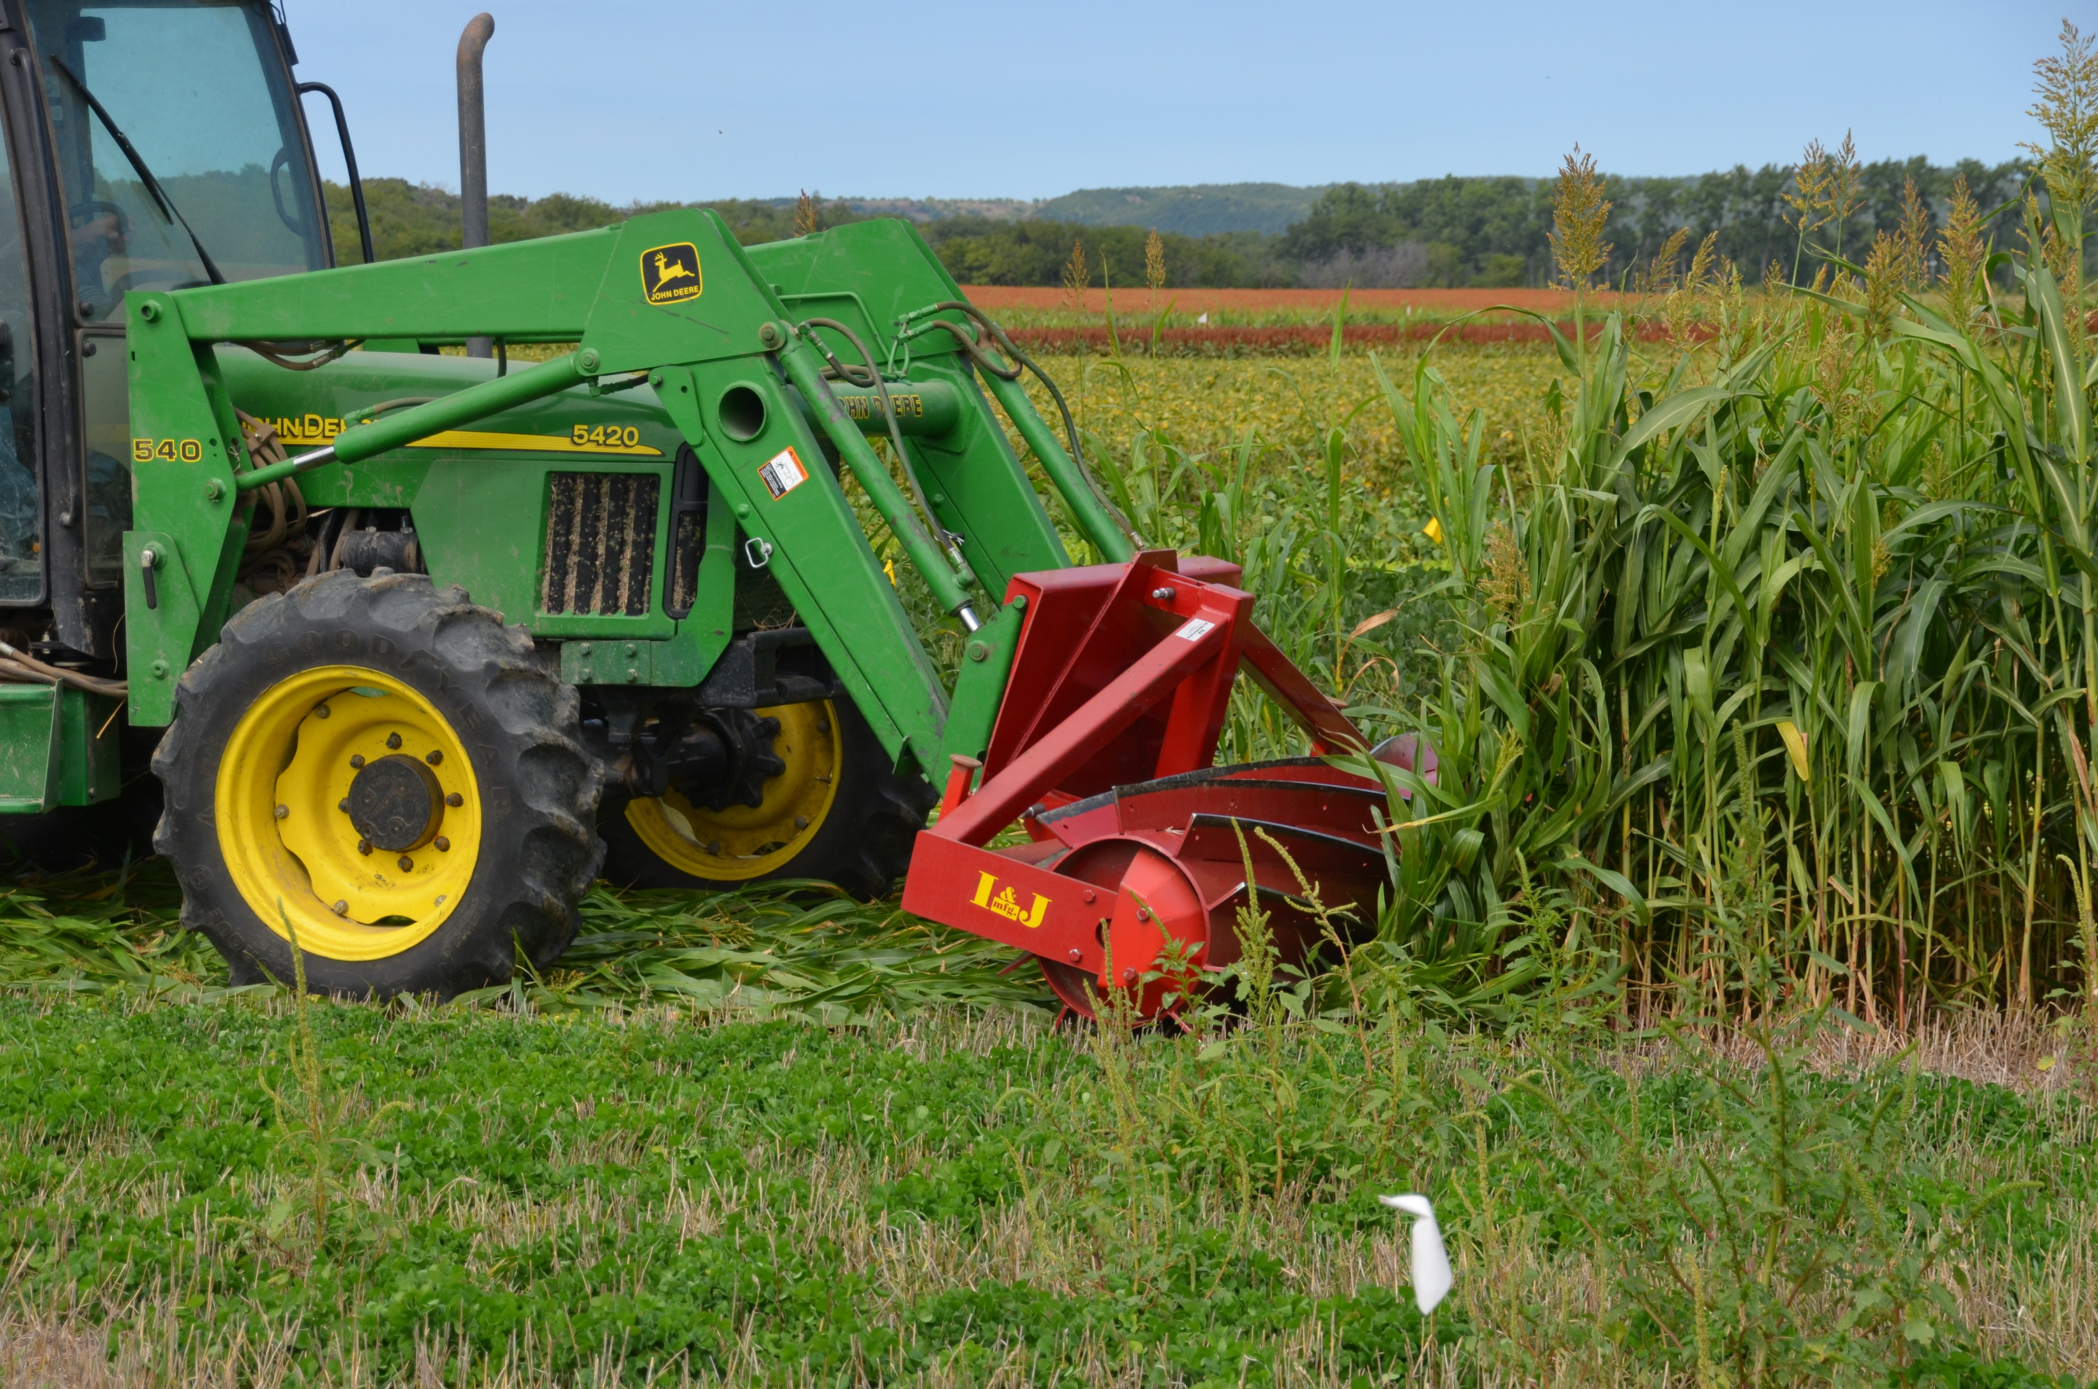
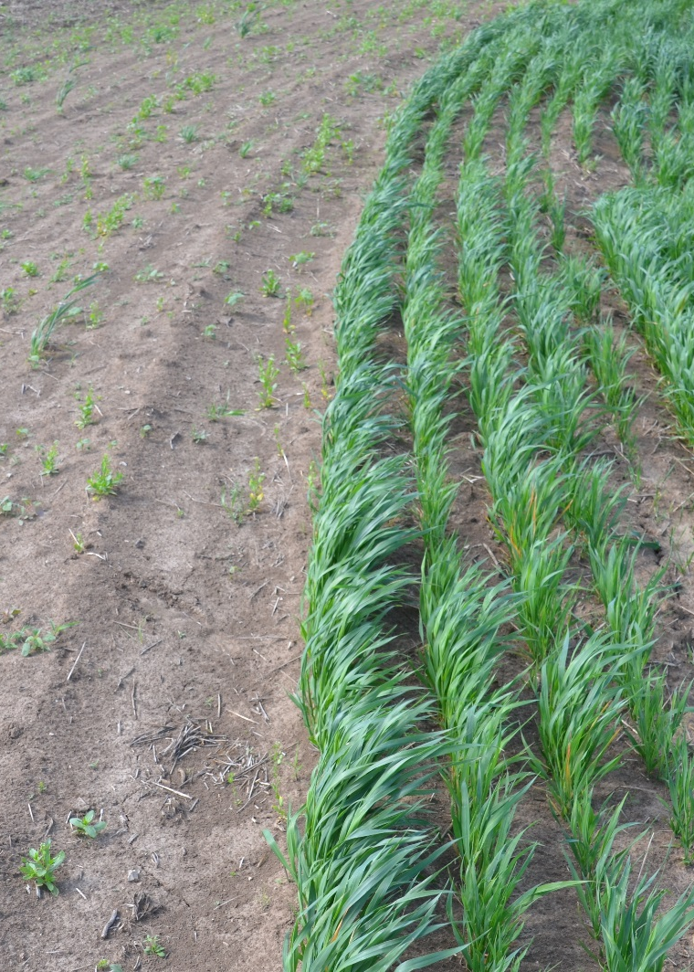
What is your Objective
Survival
Operation specific
  Build residue
  Reduce N leaching
  Weed control
  Reduce soil loss …
What are willing to spend?
  Seed costs
  Fertilizer costs
  Equipment
  Soil moisture

Slide 5
Conservation Planning
Tailored to the desired conservation planning outcome
  Production: Yield, Nutrient management, Profitability, Equipment resources, etc.
  Conservation: Soil health & conservation, Water quality, Sustainability, Climate resiliency, etc.
Consider potential side-effects
  May necessitate the overlay of additional practices
  A management paradigm shift
Shift away from simple implementation of single conservation practices or even multiple “stacked practices”
Holistic implementation of a
conservation management systems
Notes:
In areas at high risk for P loss, adjusting other management practices (e.g., nutrient placement, drainage management) may be necessary to achieve soil health objectives without further water quality degradation

Slide 6
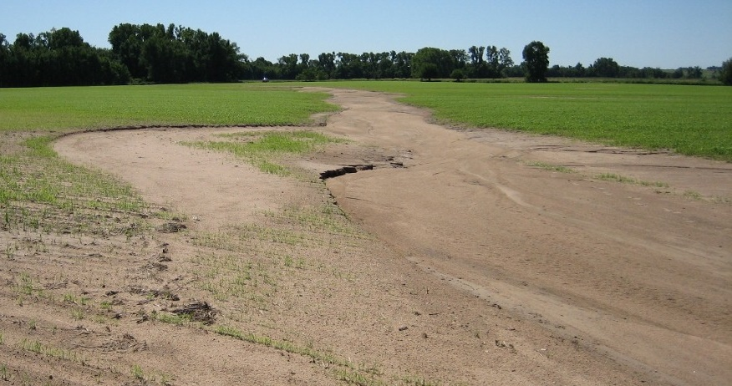
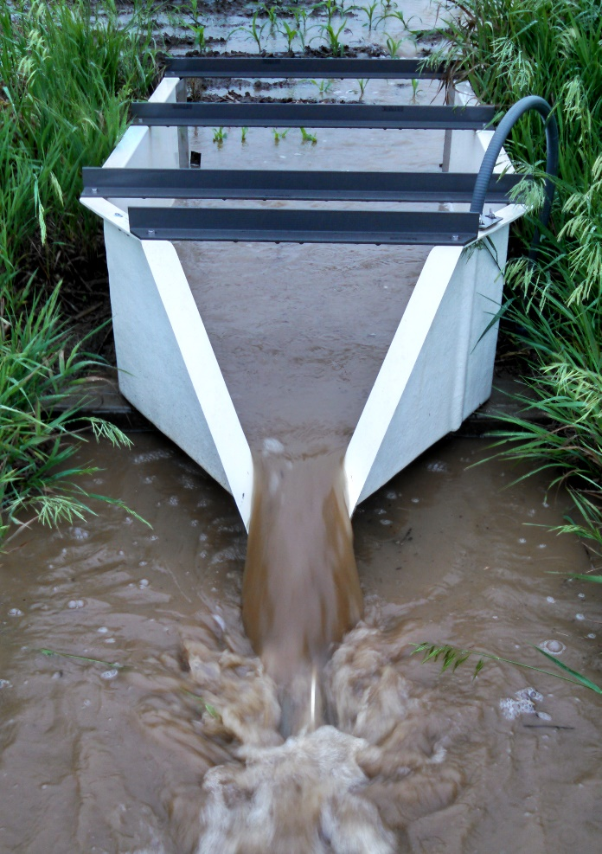
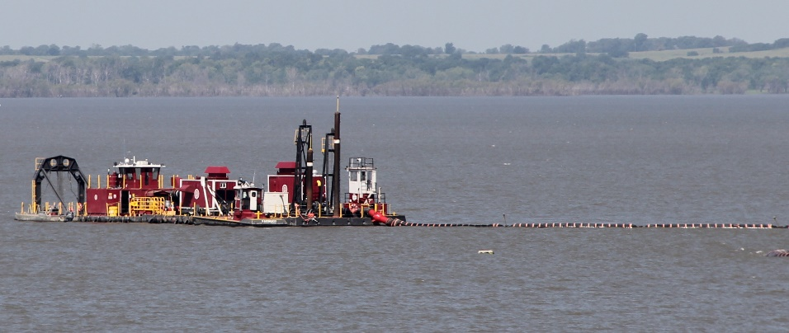
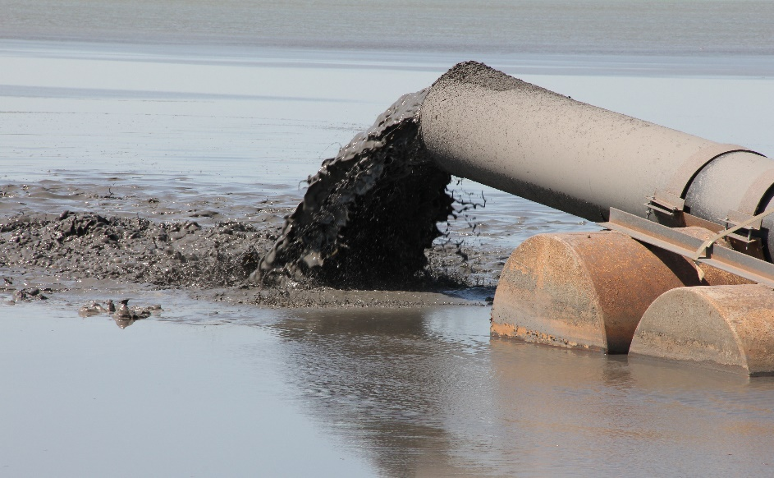
Water Quality Concerns
Sediment
deNoyelles and Kastens, 2016.
Notes:
Frank deNoyelles1,2 and Jude H. Kastens1. 2016. Reservoir sedimentation challenges Kansas. Transactions of the Kansas Academy of Science. Vol. 119(1):69-81.
1. Kansas Biological Survey, University of Kansas, Lawrence, Kansas jkastens@ku.edu
2. Department of Ecology and Evolutionary Biology, University of Kansas

Slide 7
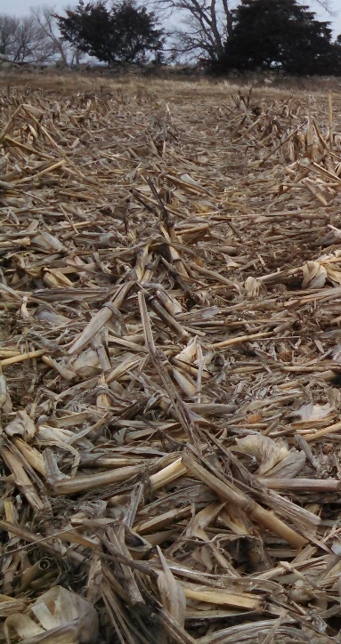
Reduce erosion with no-till
Numbers indicate number of
watershed years included in
the dataset
Data from the MANAGE v3 database (Harmel et al., 2008)

Slide 8
Nutrient Management
Challenge – producers inadvertently over-apply to avoid yield reductions (Roberts et al., 2018)
Blanco-Canqui et al. (2018) noted that cover crops effectively decreased sediment and N losses but reduced soluble P losses in fewer than 25% of studies
Nitrogen
  Excess N beyond plant demand results in an exponential increase in N₂O (Kim et al., 2013)
  Venterea et al. (2012) found that using multiple components of 4R Nutrient Stewardship lowered N₂O emissions
Phosphorus
  To date, claims that soil health practices alone can significantly reduce P losses are not substantiated by peer-reviewed literature (Duncan et al., 2019)
Notes:
In areas at high risk for P loss, adjusting other management practices (e.g., nutrient placement, drainage management) may be necessary to achieve soil health objectives without further water quality degradation

Slide 9
Reduce Total P loss with no-till
Numbers indicate number of
watershed years included in
the dataset
Data from the MANAGE v3 database (Harmel et al., 2008)

Slide 10
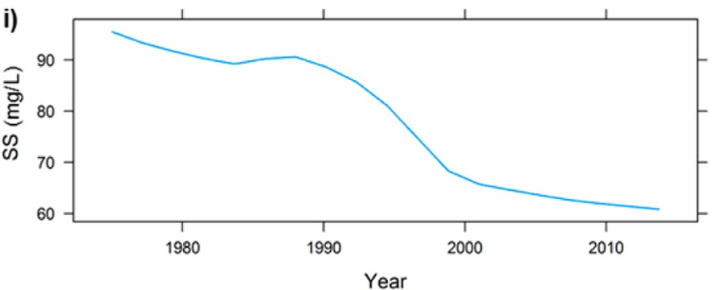
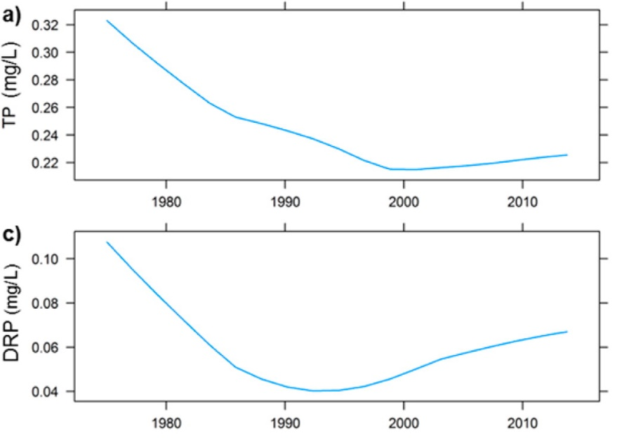
No-till can increase dissolved P loss
Effect of tillage on dissolved P loss
Dissolved P entering Lake Erie
decreasing sediment
decreasing then plateau total P
decreasing then increasing dissolved P
Data from the MANAGE v3 database (Harmel et al., 2008)
(Stow et al., 2015)
Notes:
Environ. Sci. Technol. 46:10660–10666. doi:10.1021/es302315d
Published in: Craig A. Stow; YoonKyung Cha; Laura T. Johnson; Remegio Confesor; R. Peter Richards; Environ. Sci. Technol. 2015, 49, 3392-3400.
DOI: 10.1021/es5062648
Copyright © 2015 American Chemical Society

Slide 11
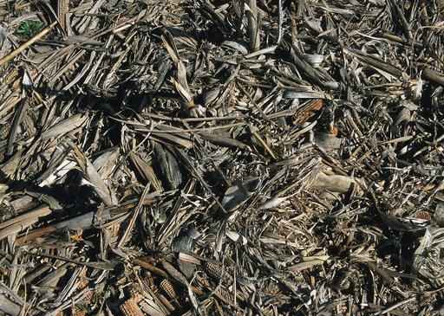
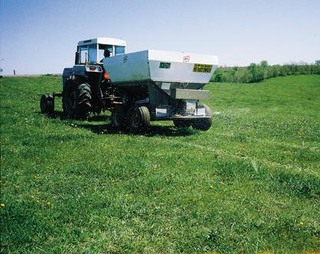
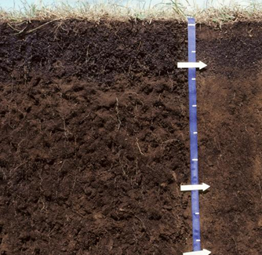
No-till can increase dissolved P loss
Potential Mechanisms
Soil stratification due to less soil mixing:
Surface P loading due to increased broadcast P fertilizer application and accumulation of plant residues
Lysed plant and microbial cells from freeze/dry, termination methods, and wet/dry periods

Slide 12
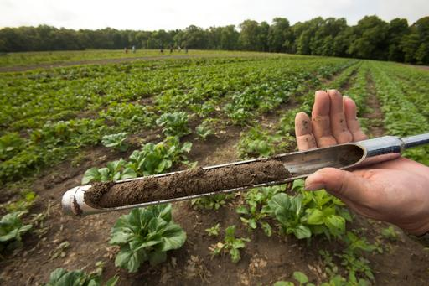
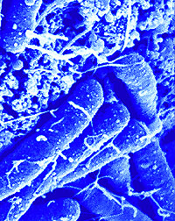
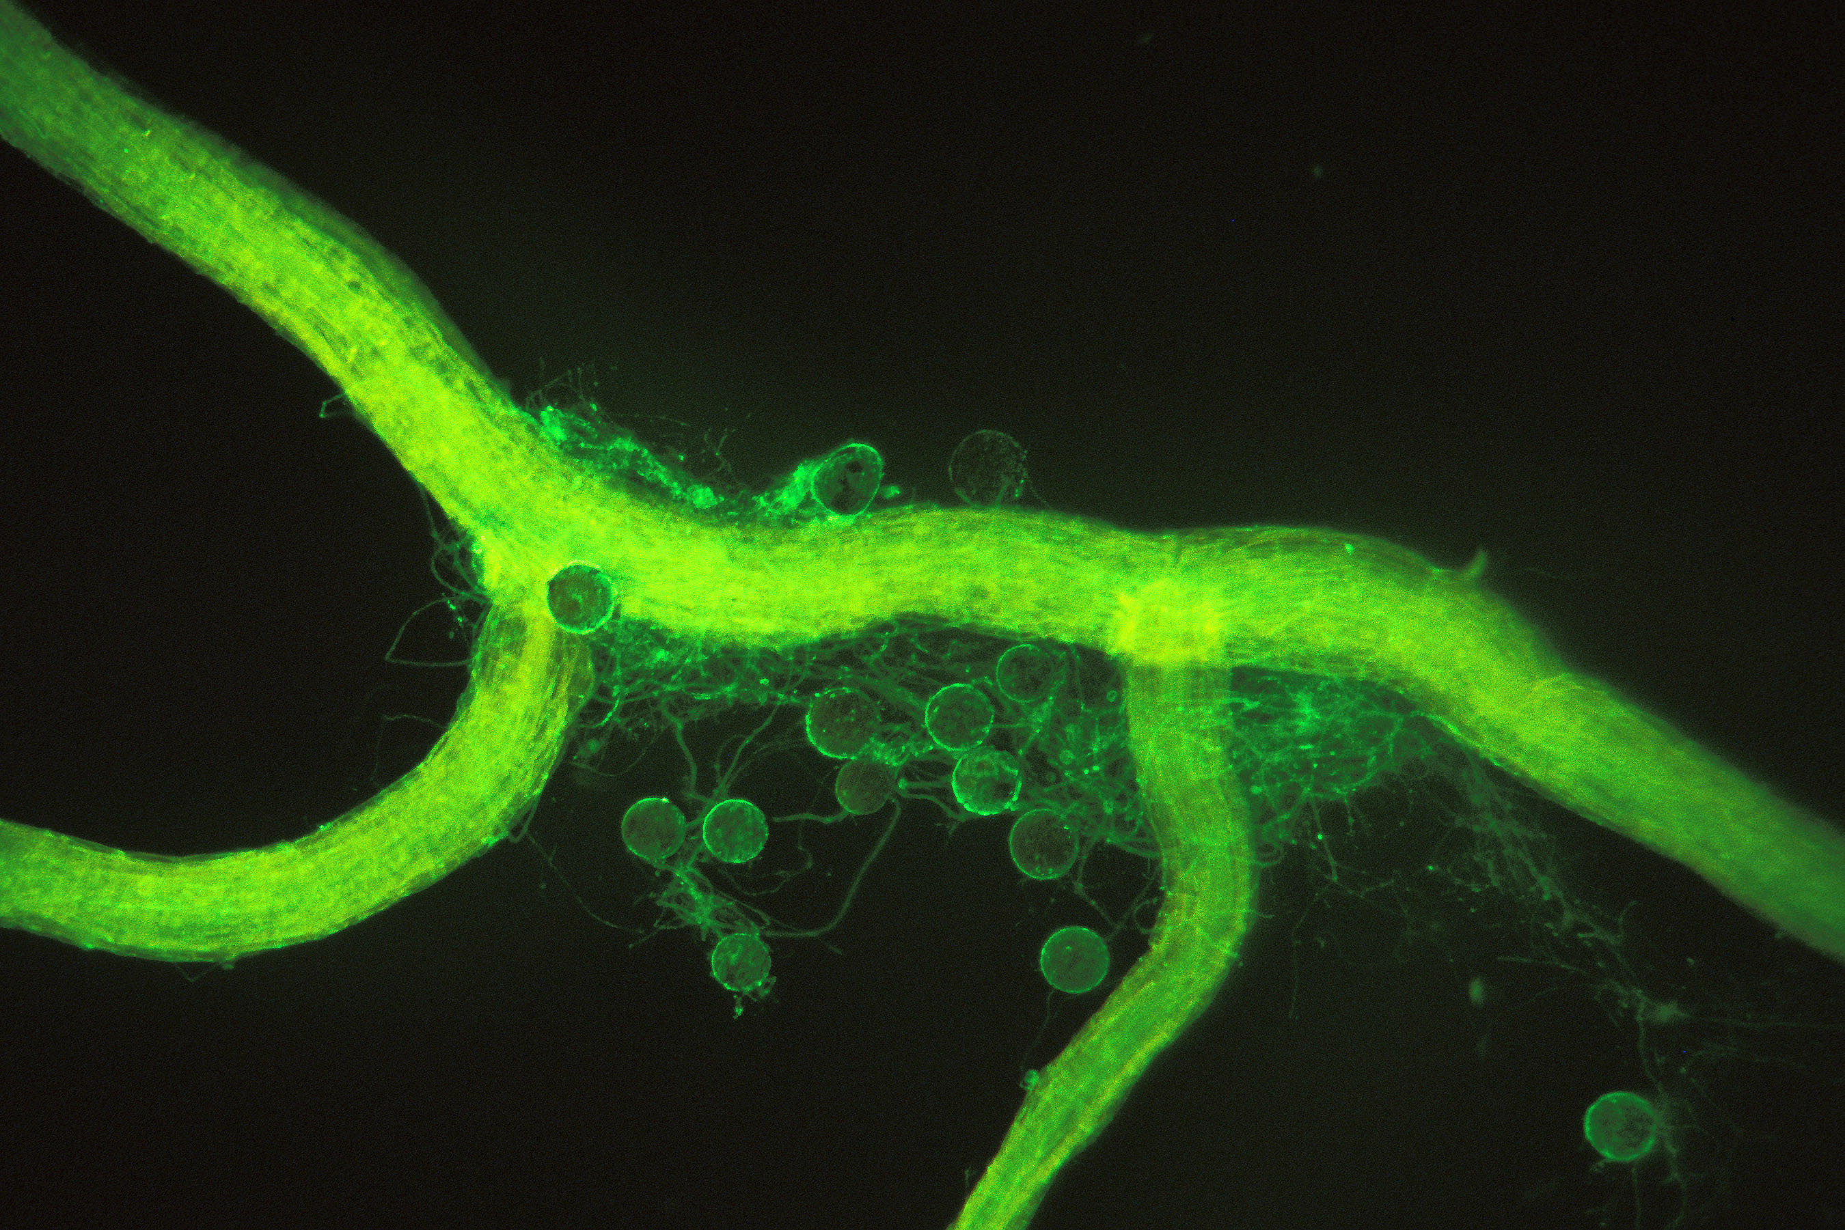
No-till can increase dissolved P loss
Potential Mechanisms
Increased SOM and microbial activity could augment mineralization efficiency
Gonzalez-Chavez et al. (2010) found no-till increased proteins related to arbuscular mycorrhizal fungi by 43%, doubled microbial biomass C and N and increased microbial biomass P by 250%
Some organic P compounds (30-65% of total P) can be more labile than ortho-P while other can compete for sorption sites
This could lead to increased soluble ortho-P and bioavailable organic P in solution

Slide 13
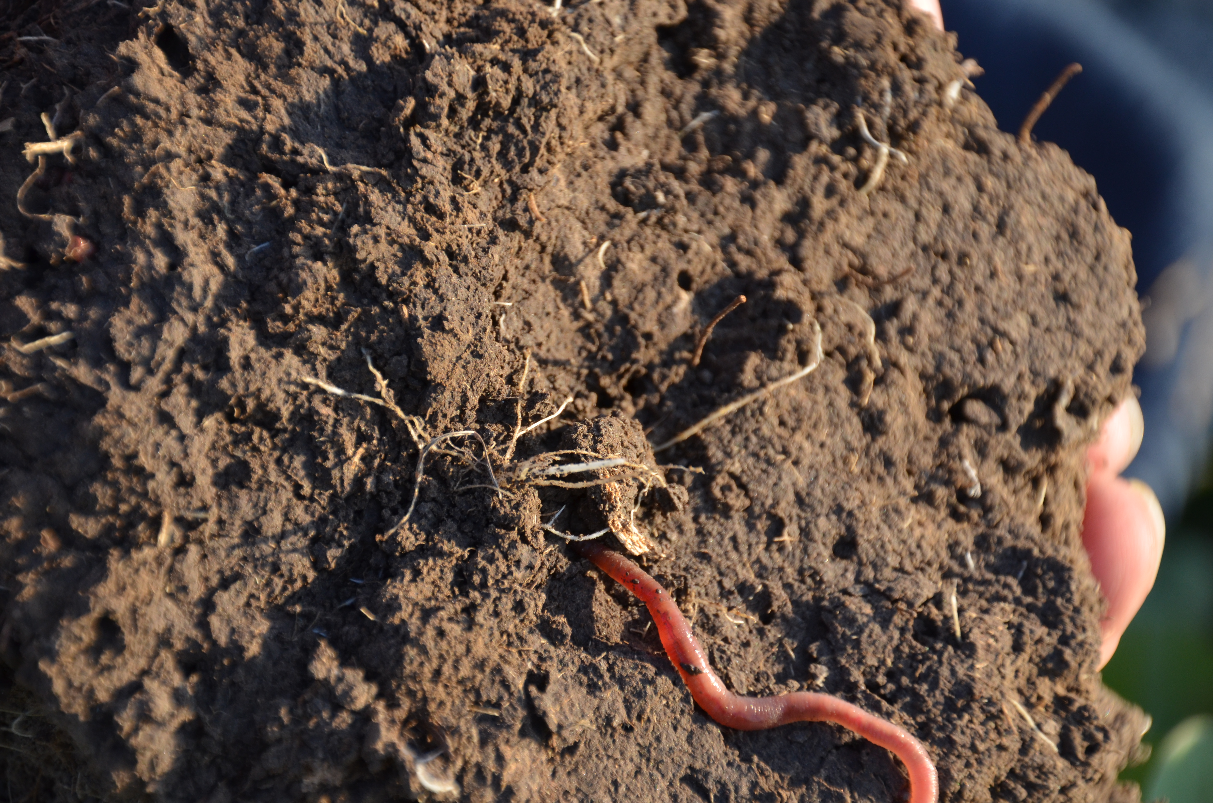
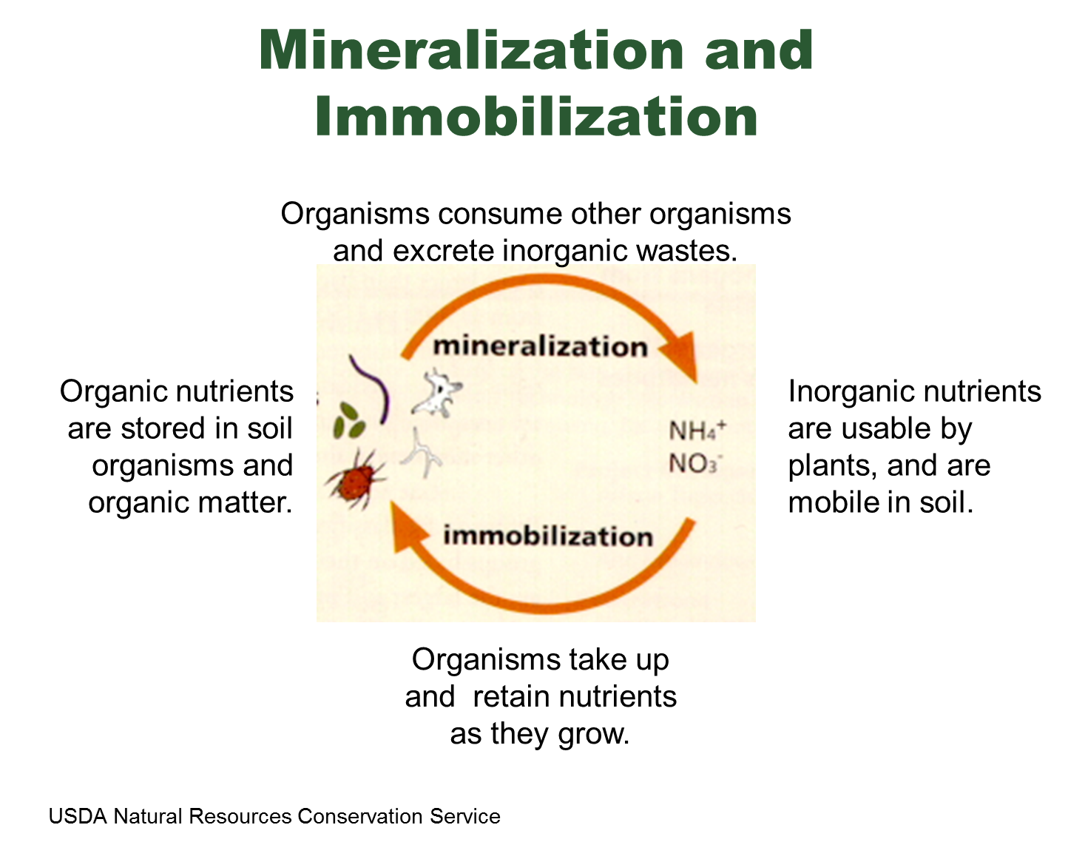
Biology and Nutrient Cycling
Nutrients (Nitrogen and Phosphorus)
  Nutrients released by decomposers
  Organisms = slow release fertilizer
    Excess nutrients excreted
    Nutrients released from organism upon death

Slide 14
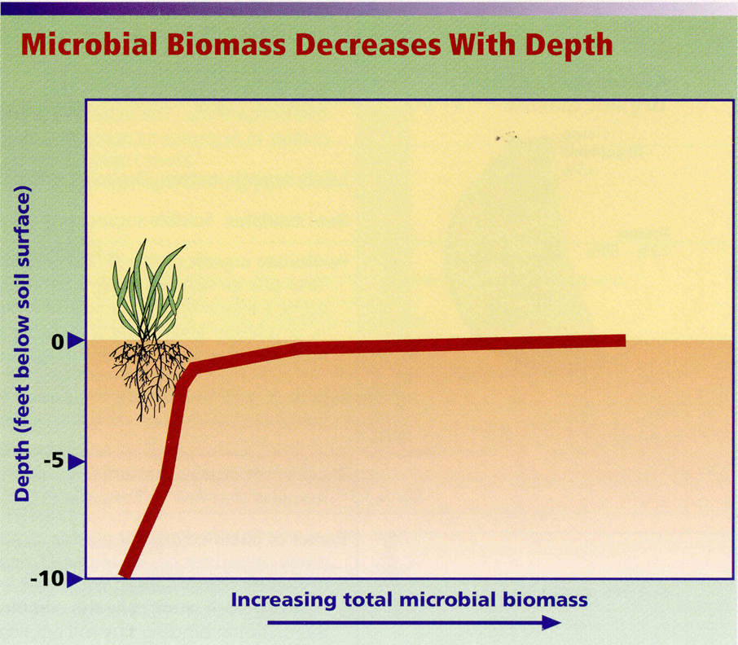
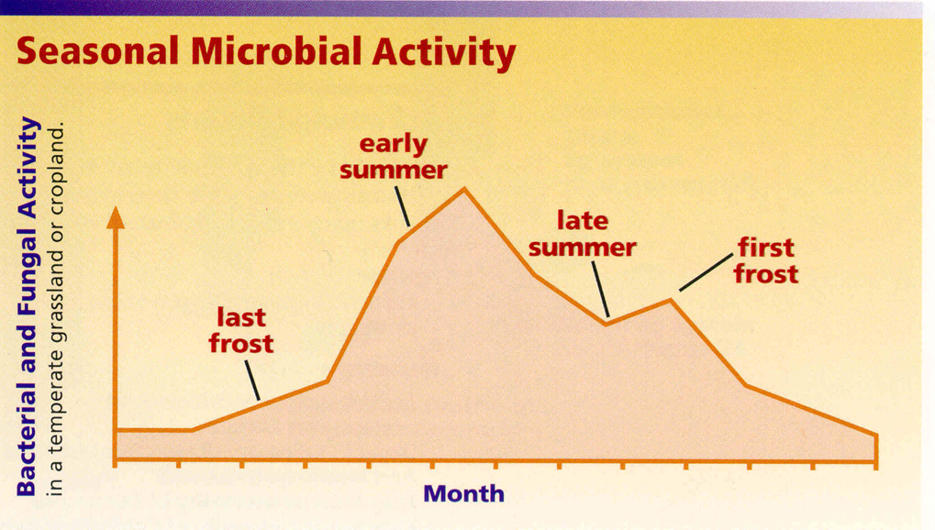

Slide 15
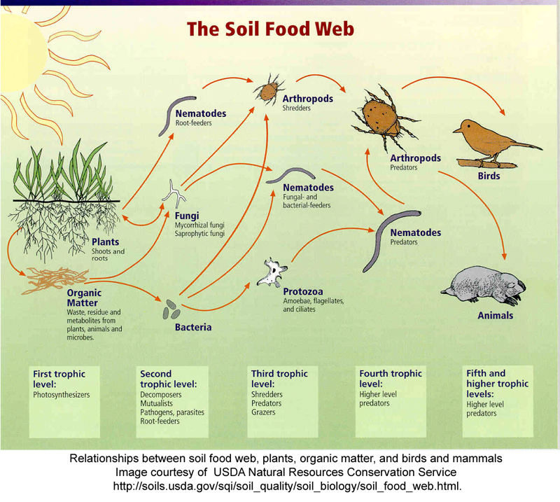
Biology and Carbon Cycling
Organic matter foundation of the soil food web
Transformed through soil organisms
Organisms involved in the processes of
  Shredding
  Decomposing
Notes:
Secret sticky binding agents
Polysaccharides and glomalin
Hold particles together (glue)
Create spaces (voids)

Slide 16
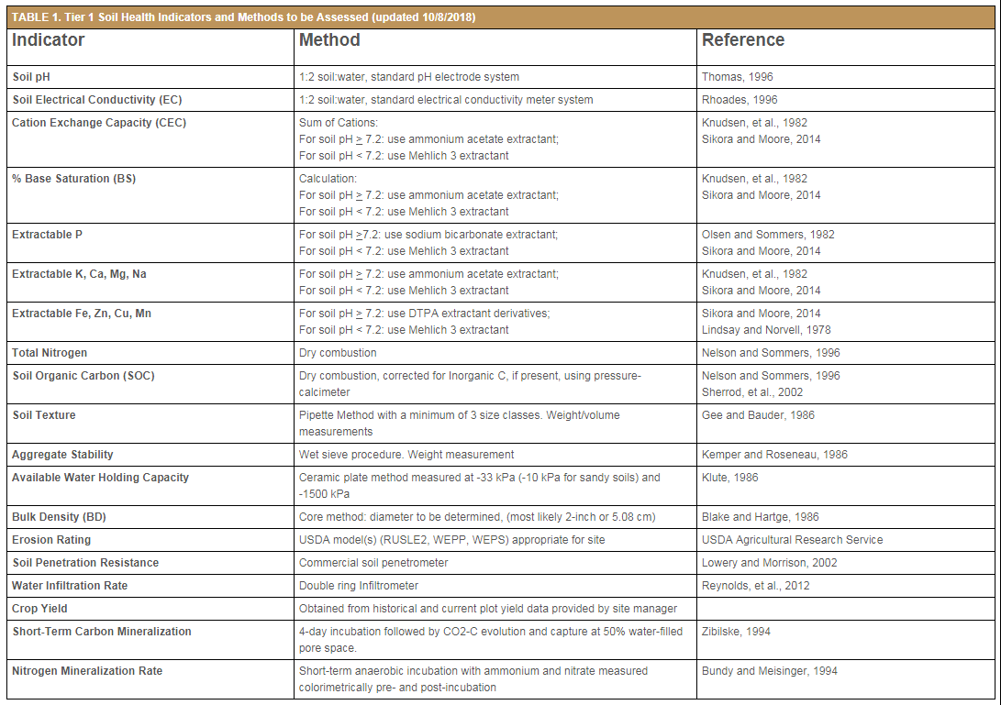
Chemical
Physical
Biological
Source: https://soilhealthinstitute.org/north-american-project-to-evaluate-soil-health-measurements/

Slide 17





Kansas Agricultural Watershed Field Laboratory
Graduate Student:
David Abel, Elliott Carver, and Laura Starr
Faculty:
Nathan Nelson, Kraig Roozeboom, Gerard Kluitenberg, Peter Tomlinson, DeAnn Presley and Jeff Williams

Slide 18
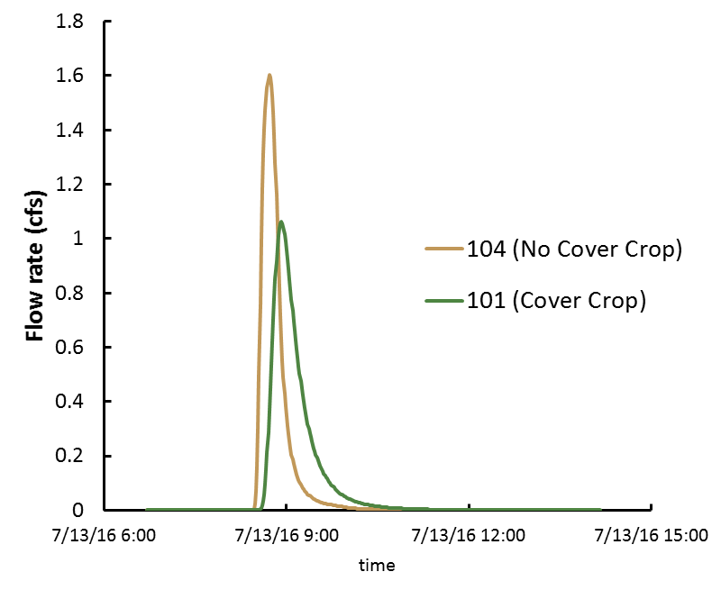
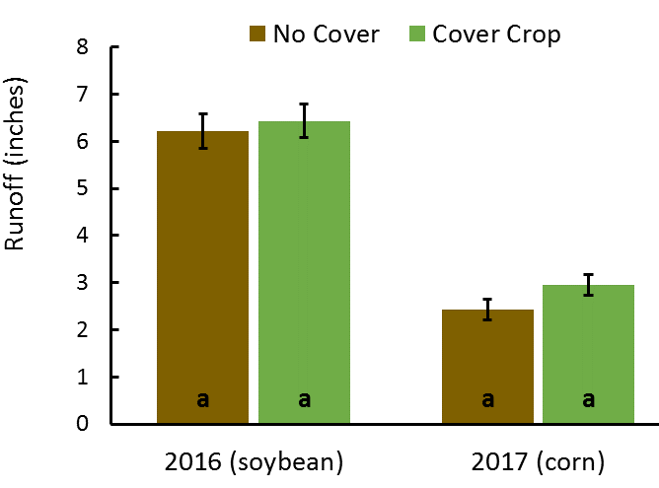
Cover crop effects on runoff
Notes:
Stats for 7/13/16 event
Inches min inches/hr
total precip 0.94 81 0.7
max 3 min rainfall 0.34 3 6.8
max 10 min rainfall 0.74 10 4.44
max 20 min rainfall 0.89 20 2.67
101 104
total runoff (ft3) 2100 2099
area (ac) 1.2 1.27
runoff (inches) 0.48 0.46
peak runoff (cfs) 1.06 1.6
time to peak (min) 28 17
time to ini. of runoff (min) 7 2
runoff duration (min) 141 102

Slide 19
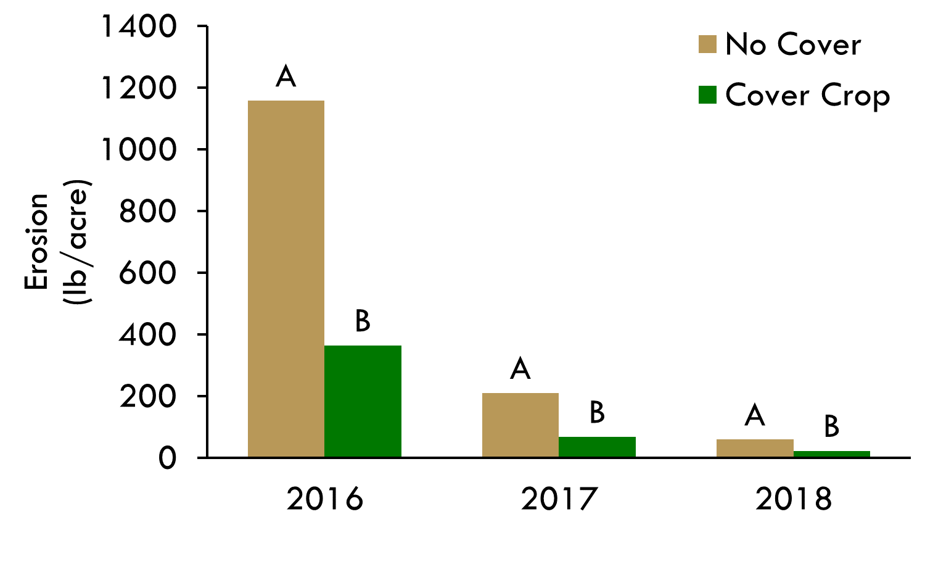
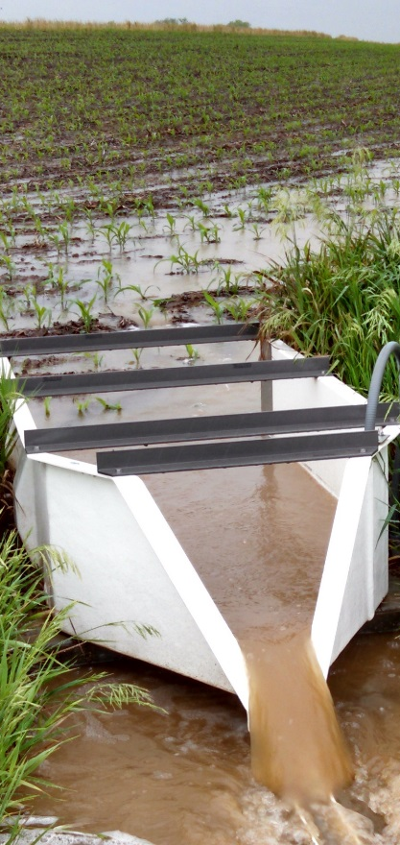
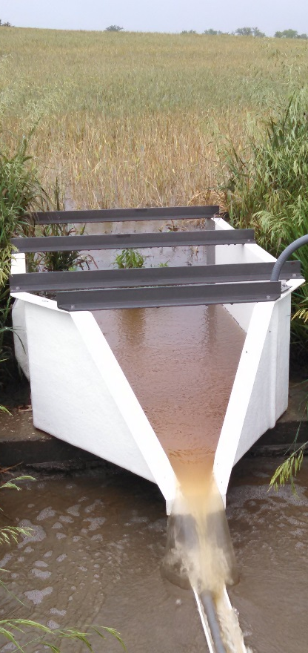
Cover crop effects on sediment
decreased erosion more than 65%

Slide 20
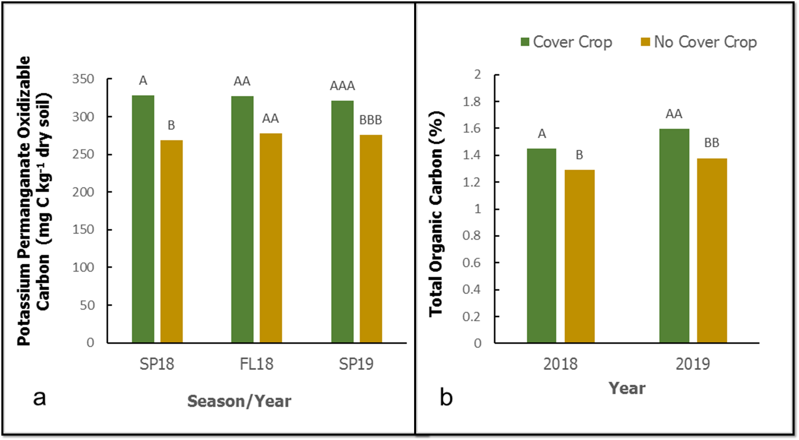
Cover crop effects on labile and total C

Slide 21
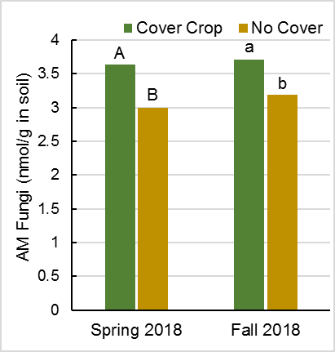
Cover crop effects on soil biological indicators

Slide 22
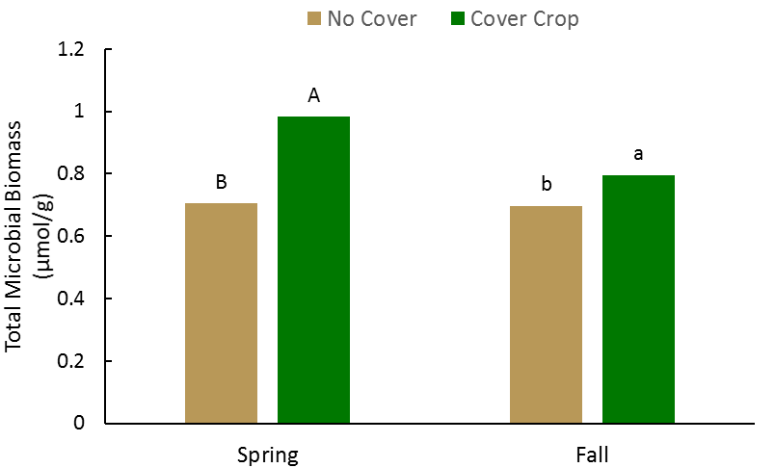
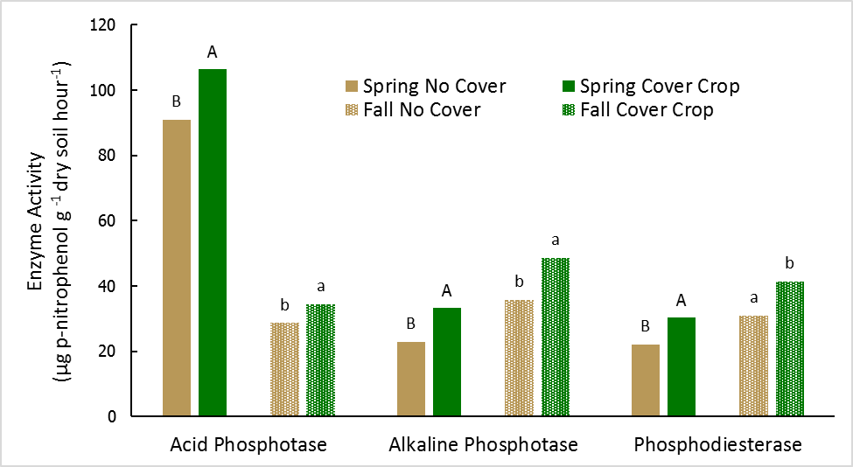
Cover crop effects on soil biological indicators

Slide 23
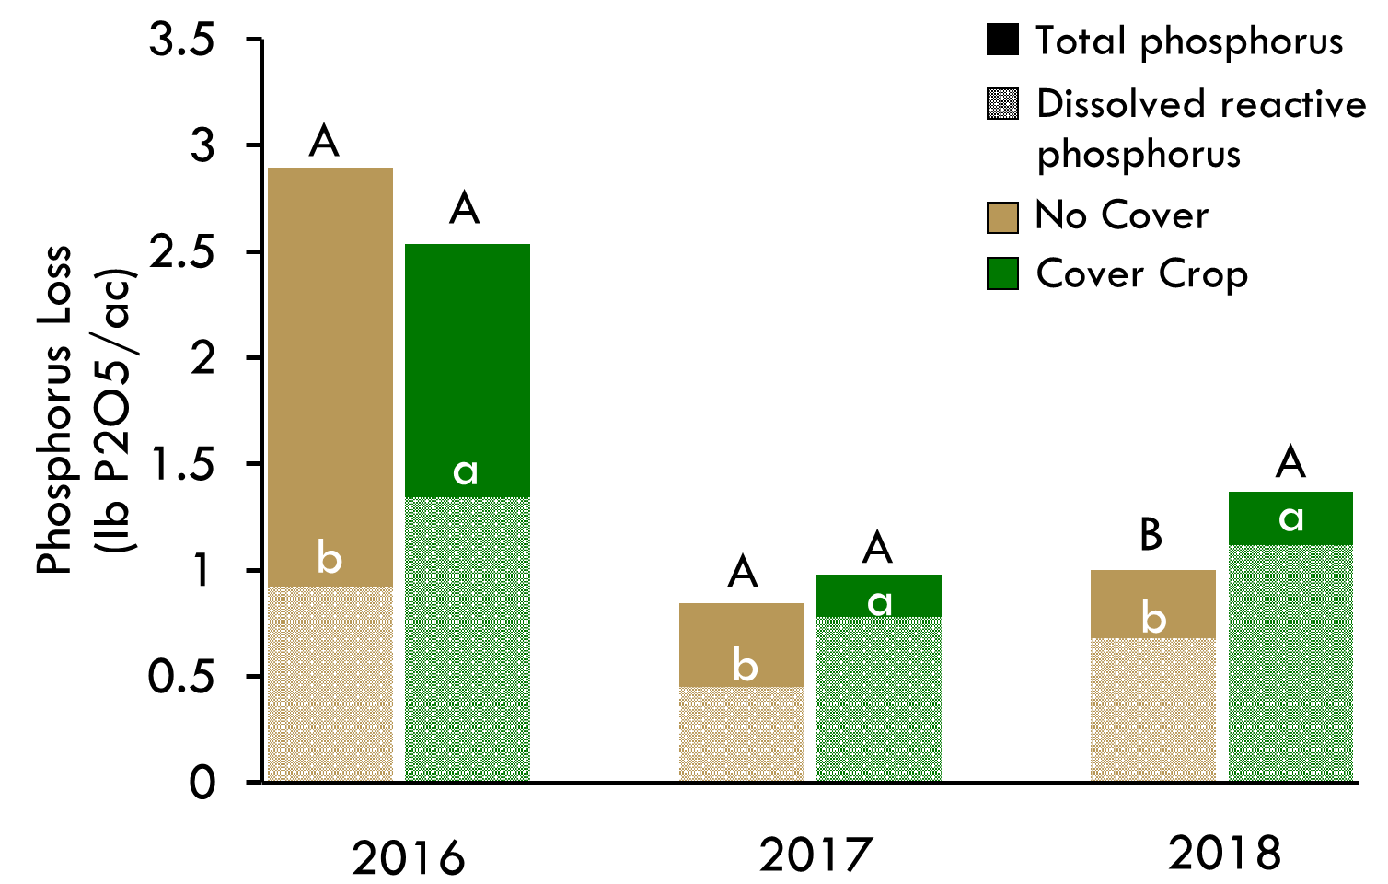
Cover crop effects on form of P loss
Increased dissolved P
65%

Slide 24
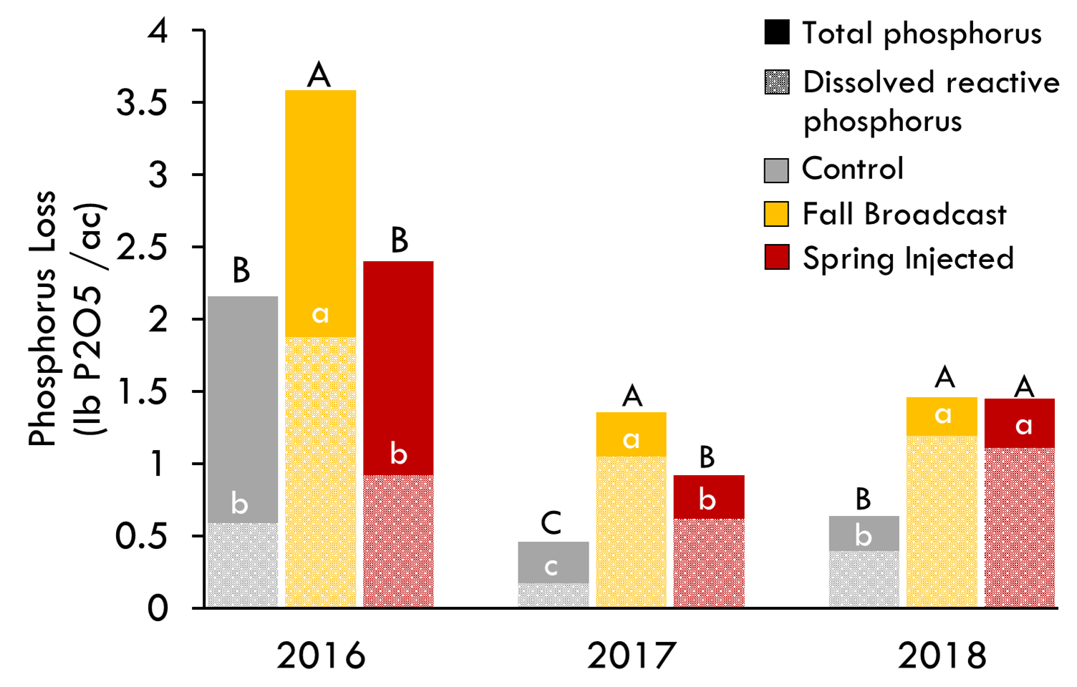
Fertilizer management effects on P loss
Notes:
SI resulted in about 30% decrease in TP and about 45% decrease in dissolved P loss. (no effect on particulate P).

Slide 25
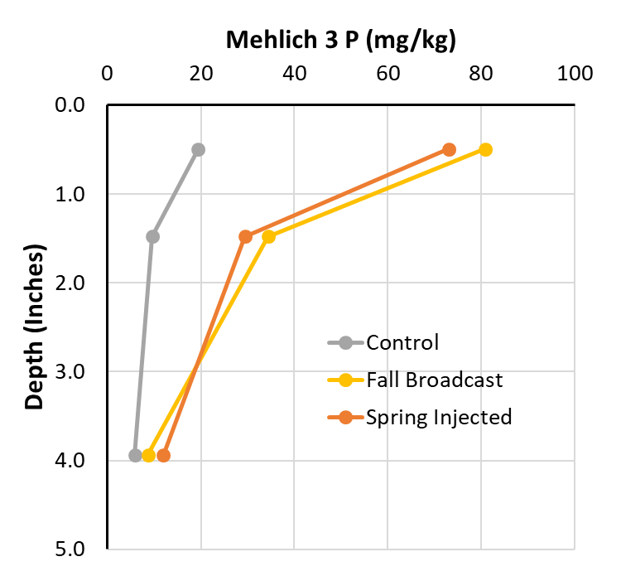
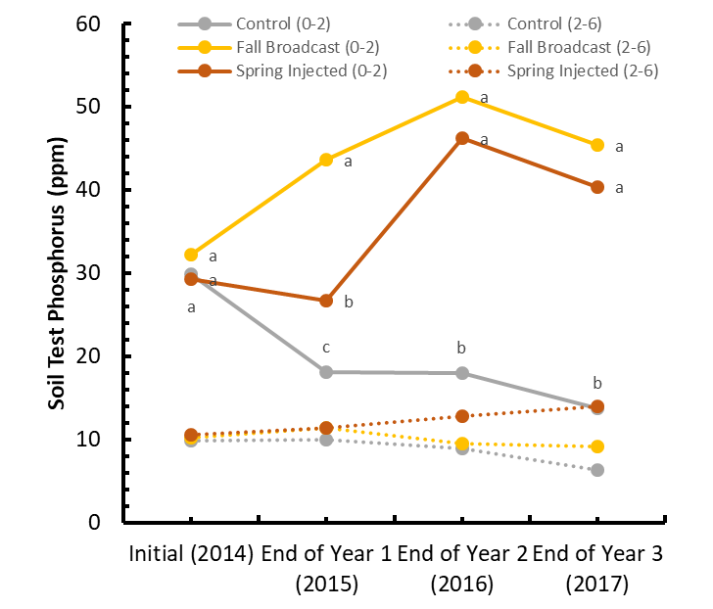
Fertilizer management effects on soil test P
Fall 2017

Slide 26
Phosphorus transport process
Rain
Particulate P transport with erosion
Dissolved P release from soil
Dissolved P release from fertilizer
0-1 inch
Interflow
Return-flow

Slide 27
Phosphorus Cycle
P in grain,
forage, fruit, etc.
Fertilizer and
Manure P
Alternate
Management
Exports
Alternate
Management
Erosion/Runoff
Dissolved P loss
Dissolved P loss
Additions
Recycling
Particulate P loss
Dissolved P loss
Residue P
Particulate P loss
Particulate P loss
Uptake
Adsorbed P
Organic P
Immobilization
Adsorption
Root
Zone
Mineralization
Dissolved P
H₂PO₄⁻ / HPO₄²⁻
Desorption
Precipitation
Secondary
Mineral P
Primary
Mineral P
Dissolution
Dissolution
Leaching
(minimal loss)
H₂PO₄⁻ / HPO₄²⁻

Slide 28
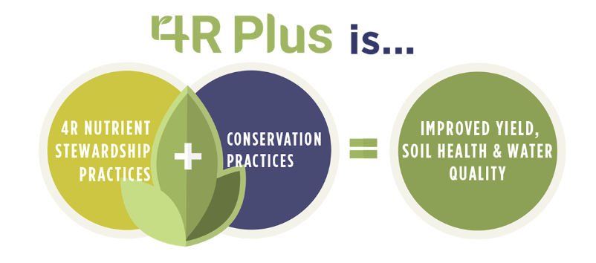
Paradigm Shift
For Example:
Holistic implementation of conservation management systems
  Nutrient management factors (rate, timing, placement, and source) should be appropriate for the conservation practices
New nutrient management paradigm:
  Managing on the margins of deficiency required to meet crop production goals.
Guided by coalition of agricultural and conservation organizations to support farmers’ efforts to implement precise nutrient management and conservation practices. www.4rplus.org

Slide 29
On the Horizon for Kansas
Your Resource on Environmental Issues
Extension Representative on State Conservation Commission
Grants
  USDA-ARS Coop Agreement with K-State and Oklahoma State
    Nitrogen Management and N₂O emissions for life cycle assessment as a biofuel feed stock
  USDA-AFRI Sustainable Agricultural Systems Projects
    Enhancing the Sustainability of US Cropping Systems through Cover Crops and an Innovative Information and Technology Network (Tomlinson and Presley)
  USDA-NRCS Conservation Innovation Grants
    Linking microbial functional diversity to soil health and ecosystem services (Tomlinson)
  Heartland-EDEN (Extension Disaster Education Network)
    Address the need for regional coordination and leveraging of existing disaster preparedness and recovery resources in Iowa, Kansas, Nebraska, and Missouri

Slide 30
Thank you
Peter Tomlinson - Environmental Quality
(ptomlin@ksu.edu)
Department of Agronomy, Kansas State University

Slide 31
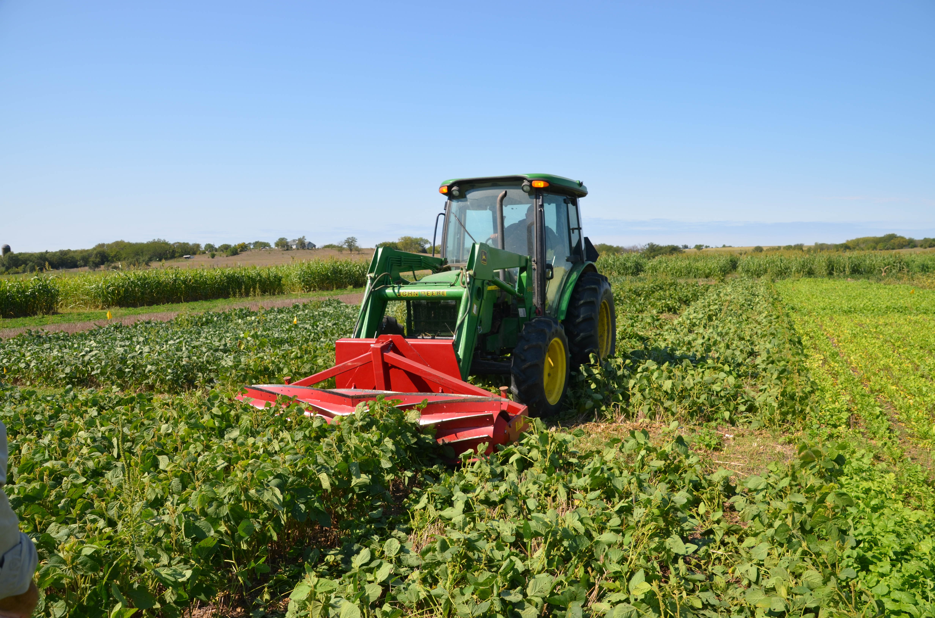
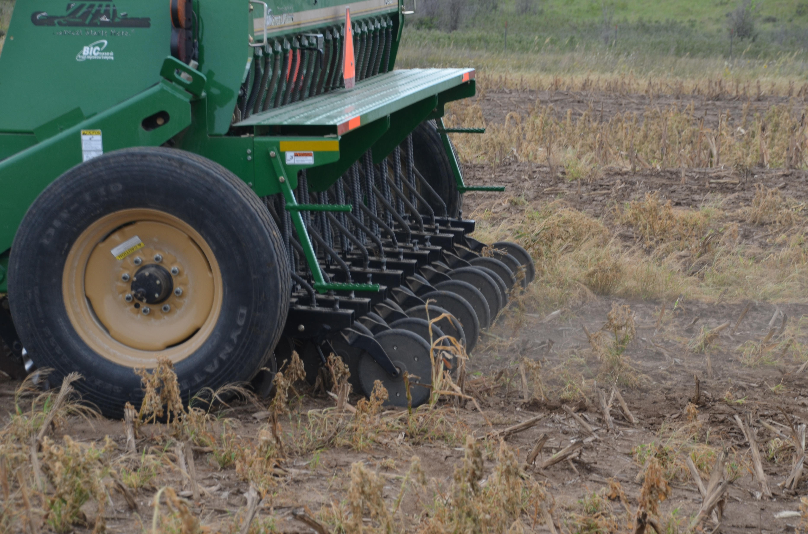
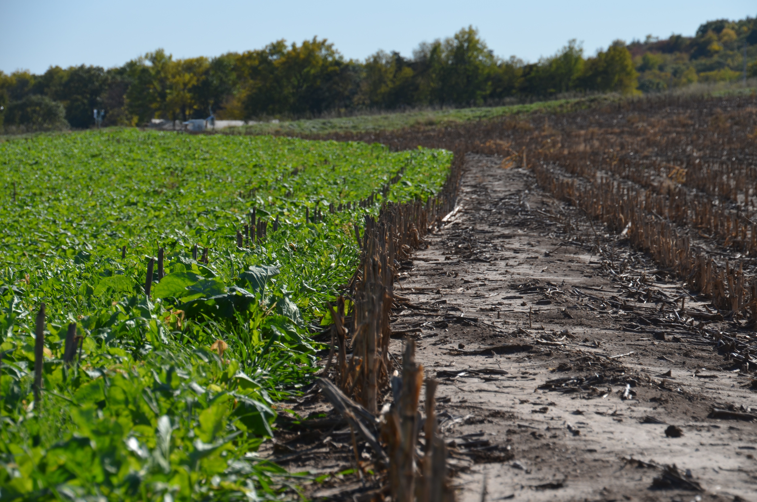
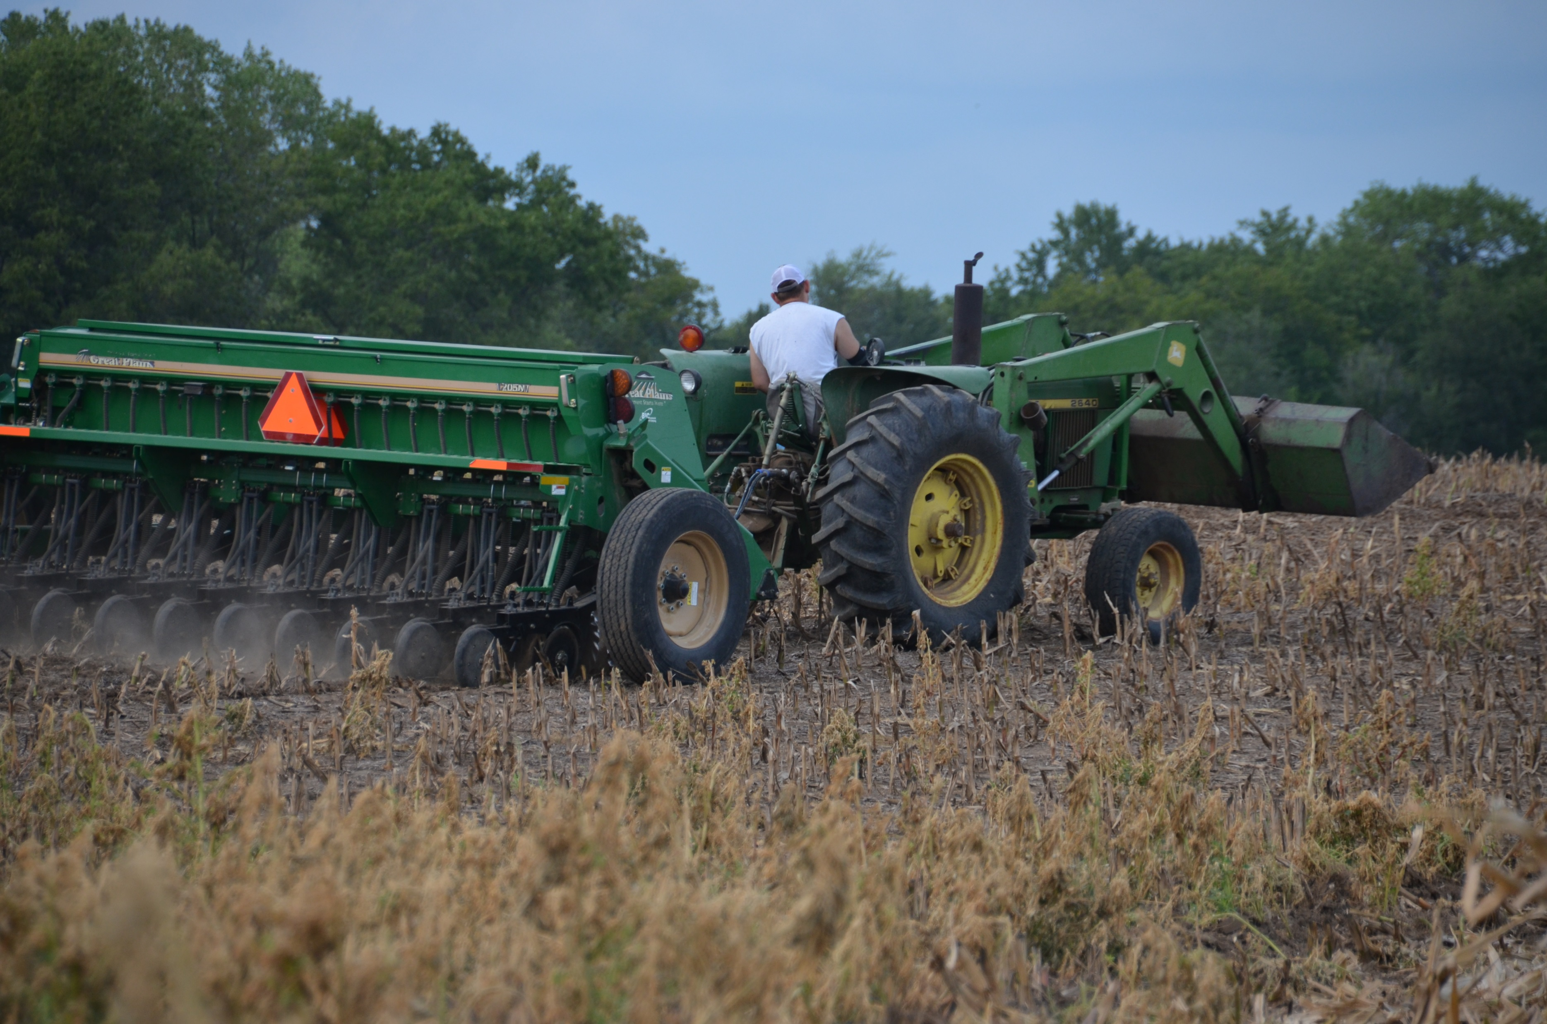
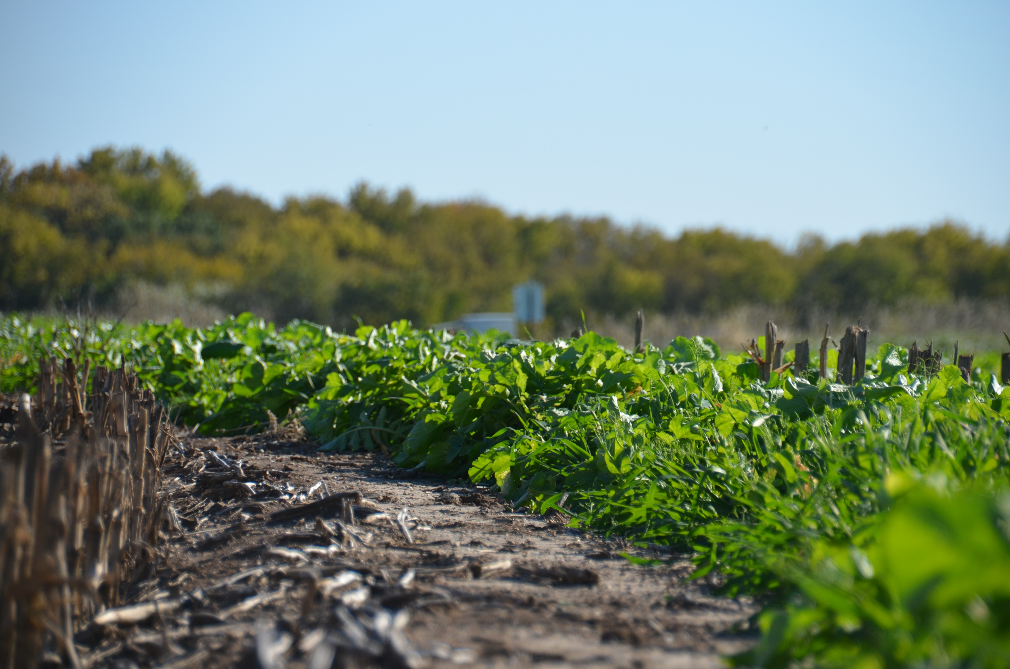
Failed Corn
Anhydrous for 120bu/ac
Chopped early August
Cover crop planted
early September
Mix Includes:
40lbs Triticale
3lbs Sorghum/Sudangrass
20lbs Peas
2lbs Radish
1lb Turnip
1lb Rape

Slide 32
Denitrification
Denitrification: microbial use of NO₃⁻ as an O₂ source in wet conditions:
Controlled by: soil pH, texture, temperature, organic C and mineral N supply, water/oxygen status
Mosier et al. (2002)
WFPS 30-60%: NO emissions
WFPS 50-80%: N₂O emissions
WFPS > 80%: N₂ emissions

Slide 33
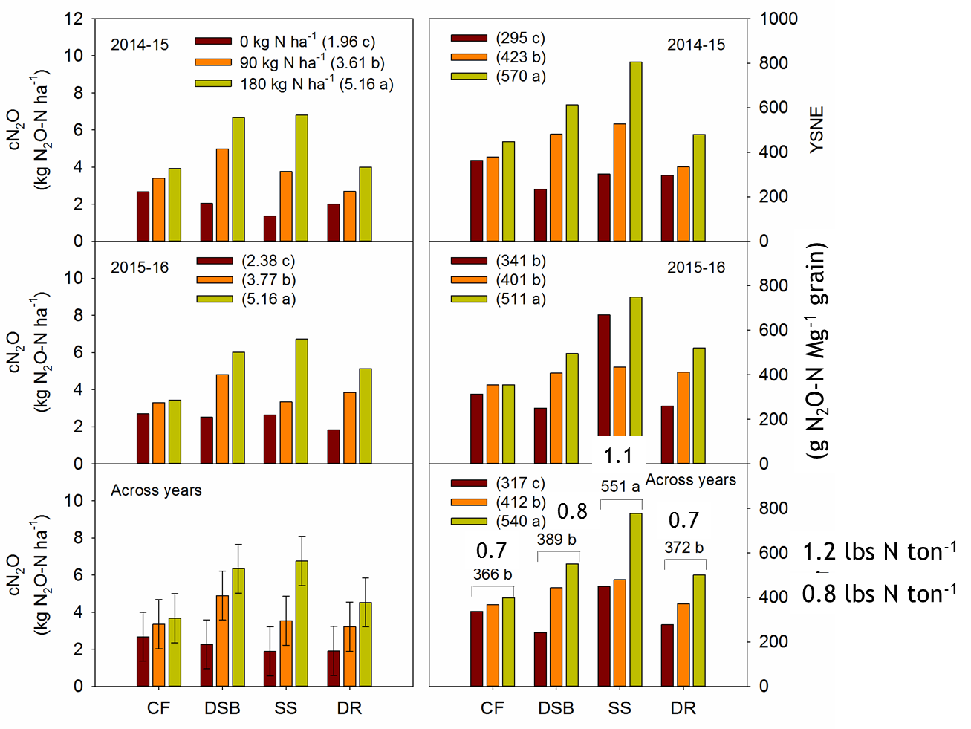
Cumulative Emissions
Yield Scaled Emissions

Slide 34
N Fertilizer Replacement Value
Regression equation of grain yield for chemical fallow as a function of N fertilizer rate
Solved the equation substituting the mean grain yield at 0-N for each cover crop treatment
Cover crop treatment | Mean grain yield at 0 N rate (bu ac⁻¹) | Fertilizer N equivalent value (lb N ac⁻¹)
Chemical fallow | 88 b | -
Double-crop soybean | 91 b | 8 b
Summer legume | 100 a | 30 a
Summer non-legume | 64 c | -45 c
Winter legume | 87 b | -1 b
Winter non-legume | 87 b | -3 b
¹Means with different letters within columns are significantly different (LSD=0.05)
Preza Fontes, G., P. Tomlinson, K. Roozeboom, and D. Ruiz Diaz. 2017. Grain Sorghum Response to Nitrogen Fertilizer Following Cover Crops. Agronomy Journal. DOI: 10.2134/agronj2017.03.0180. 109(6) 2723-2737. KAES# 17-286-J.

Slide 35
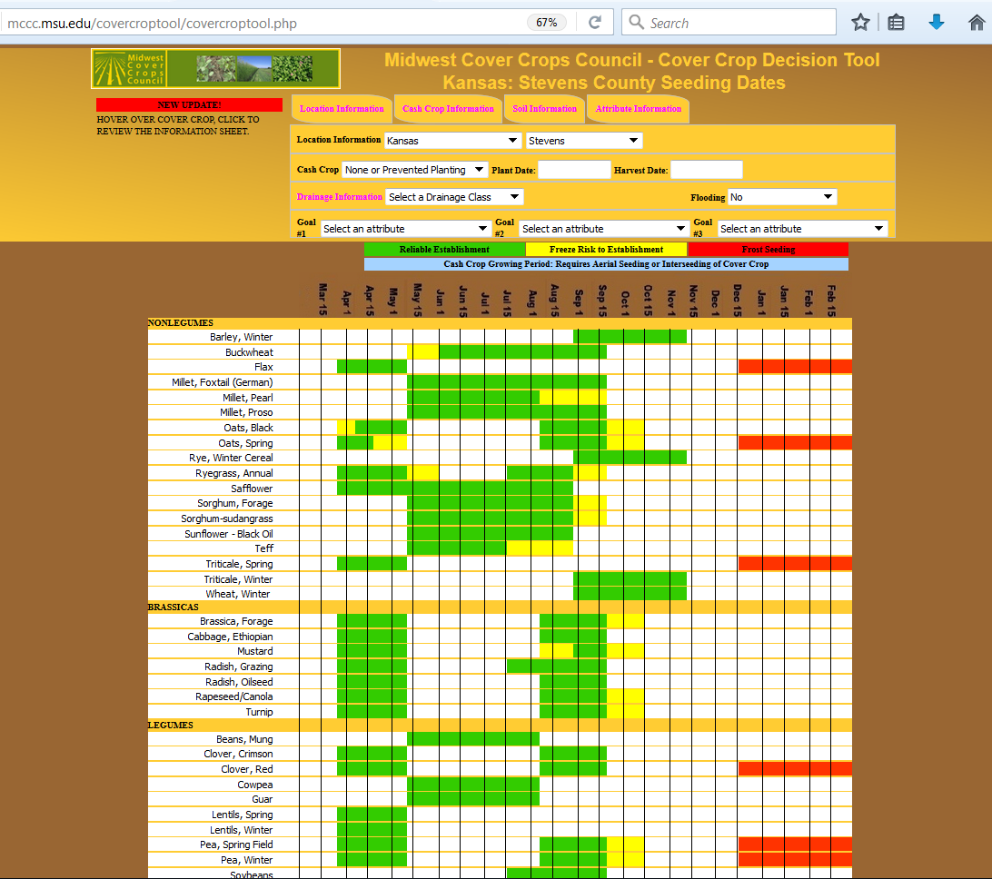
mccc.msu.edu

